Slide 1
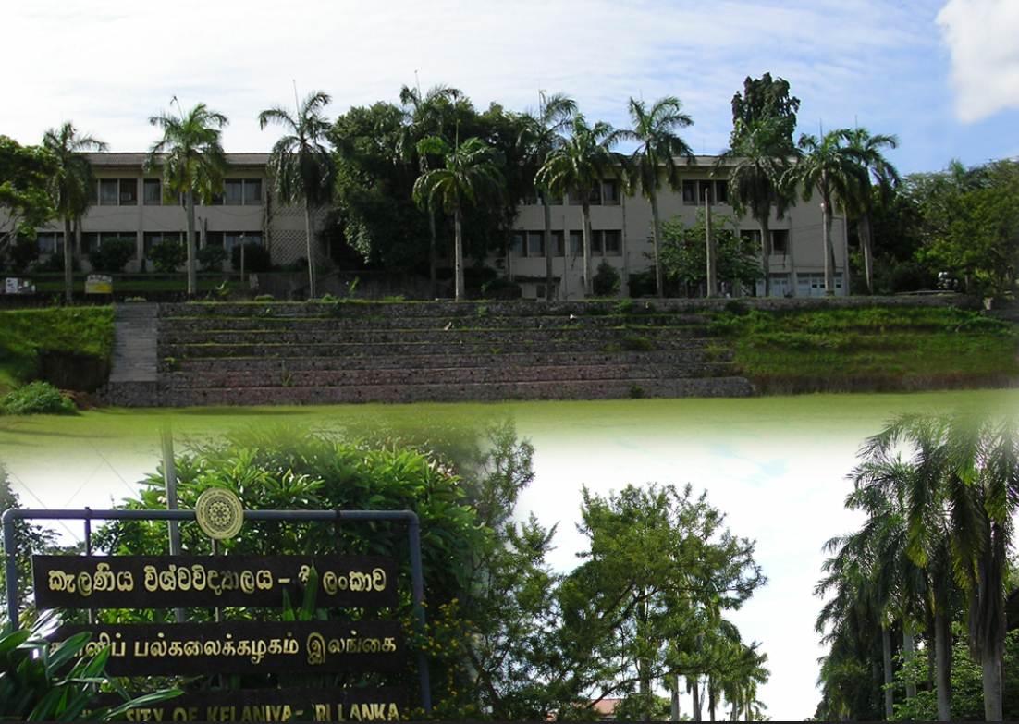
Geodata for Humanitarian Affairs in UN Organisations
Prof. Dr. Franz-Josef Behr, Stuttgart University of Applied Sciences
ICTES 2014, University of Kelaniya, Sri Lanka
http://en.wikipedia.org/wiki/University_of_Kelaniya#mediaviewer/File:Unikelruki.jpg

Slide 2
Outline
Introduction – the UN environmental ecosystem
A closer look to some units (UNEP, OCHA, UNOSAT)
Some general aspects:
  Data proliferation
  obstacles hampering interoperability
Approaches to enable interoperability
  CODs, FODs, P-Codes, Linked Data
Summary

Slide 3
Charter of the United Nations (1945)
To maintain international peace and security, ...
To develop friendly relations among nations based on respect for the principle of equal rights and self-determination of peoples, ...
To achieve international co-operation in solving international problems of an economic, social, cultural, or humanitarian character, and in promoting and encouraging respect for human rights and for fundamental freedoms for all...
Approx. 36 agencies
Complex, fragmented
Eco-system
Sub-optimal funded
Notes:
nd to that end: to take effective collective measures for the prevention and removal of threats to the peace, and for the suppression of acts of aggression or other breaches of the peace, and to bring about by peaceful means, and in conformity with the principles of justice and international law, adjustment or settlement of international disputes or situations which might lead to a breach of the peace;

Slide 4
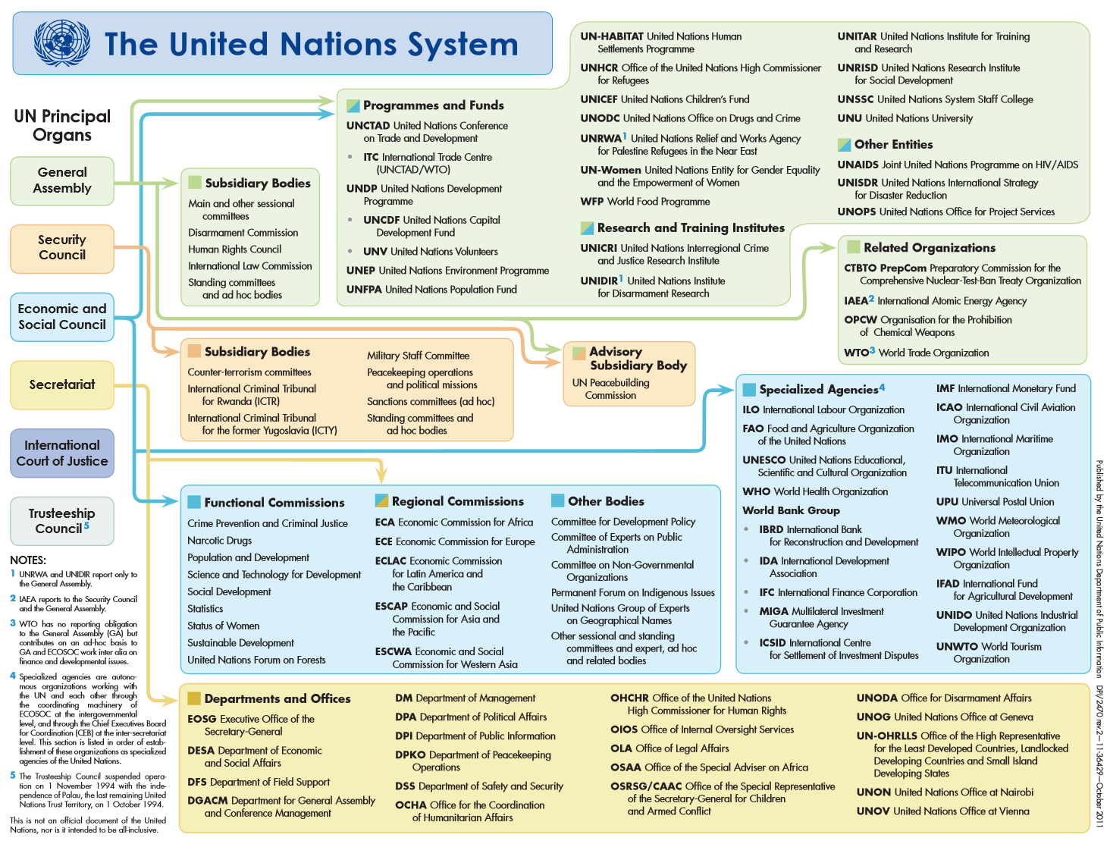
2
1
Source: http://www.un.org/en/aboutun/structure/pdfs/un-system-chart-color-sm.pdf
3
Notes:
Another primary purpose of the UN is "to achieve international co-operation in solving international problems of an economic, social, cultural, or humanitarian character".Numerous bodies have been created to work toward this goal,
The UN Charter stipulates that each primary organ of the UN can establish various specialised agencies to fulfill its duties.
Some of the best-known agencies are the International Atomic Energy Agency, the Food and Agriculture Organization, UNESCO (United Nations Educational, Scientific and Cultural Organization), the World Bank, and the World Health Organization (WHO). The UN performs most of its humanitarian work through these agencies.

Slide 5
A closer look to some units

Slide 6
Some Programmes / Departments
In Geneva
  UNEP
  OCHA: Office for the Coordination of Humanitarian Affairs
  UNITAR / UNOSAT
UNGIWG: United Nations Geographical Information Working Group: voluntary network of UN professionals working in the fields of cartography and geographic information science.
UN-SPIDER: United Nations Platform for Space-based Information for Disaster Management and Emergency Response
UNSDI: United Nations Spatial Data Infrastructure
  link with public (and private) geospatial and SDI capacities
Furthermore (for your own investigations):
Lorant Czaran (2013): The United Nations Geographic Information Working Group.
http://www.gsdi.org/gsdiconf/gsdi14/slides/3.1d.pdf

Slide 7


UNEP
Mission: To provide leadership and encourage partnership in caring for the environment by inspiring, informing, and enabling nations and peoples to improve their quality of life without compromising that of future generations.
environmental governance with regard to terrestrial, marine, and atmosherical ecosystems, and green economy.
Divisions and offices in many countries http://www.unep.org/Documents.Multilingual/Default.asp?DocumentID=296
Source: https://en.wikipedia.org/wiki/File:UNEP_logo.svg

Slide 8
UNEP/DEWA/GRID-Geneva
The acronyms:
  DEWA: Division for Early Warning and Assessment
  GRID: Global Resource Information Database -> (geo-) data
Partner: UNEP, the Swiss Federal Office for the Environment (FOEN) and the University of Geneva (UniGe)
Projects:
  UNEP-Live (http://www.uneplive.org): Maps, charts, data
  GeoNetworkPortal
  [enviroSPACE lab (http://www.unige.ch/envirospace): GIS, remote sensing, relational data bases and statistical analyses, as well as dedicated modeling tools in Ecology, Hydrology, Demography, Climate, Risks or Land Cover analyses. ]

Slide 9
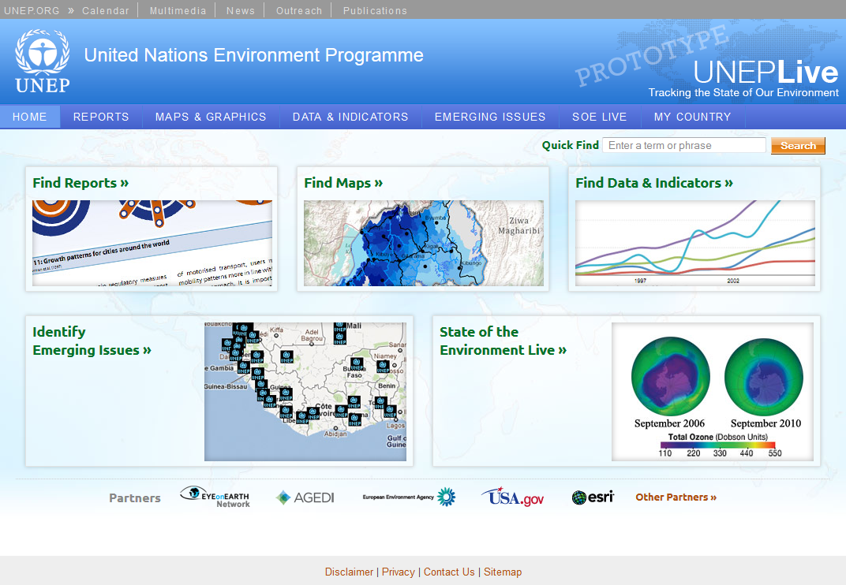
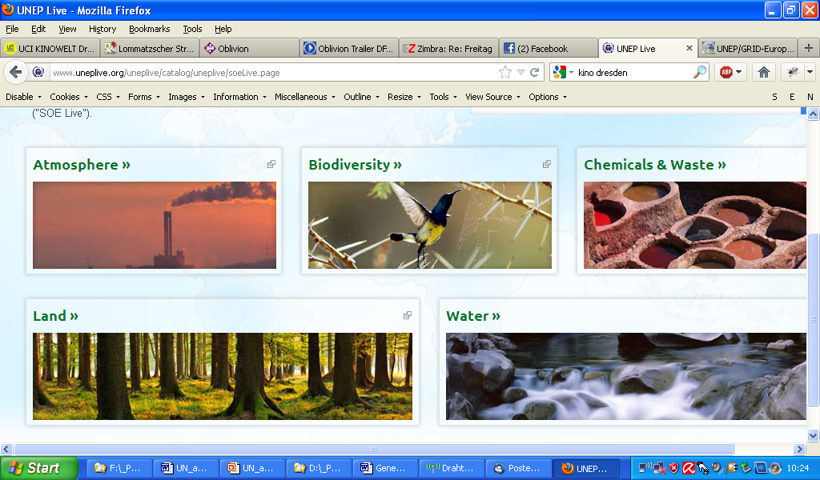
Notes:
Search
Select dataset
Visualize or download

Slide 10



GeoNetwork Portal Sites
WFP
“a standardized and decentralized spatial information management environment, designed to enable access to geo-referenced databases, cartographic products and related metadata from a variety of sources, enhancing the spatial information exchange and sharing between organizations and their audience, using the capacities of the internet.”
“… facilitating a wide community of spatial information users to have easy and timely access to available spatial data and to existing thematic maps that might support informed decision making.”
Supported by FAO, WFP, UNEP
Based on GeoNetwork opensource
  a catalog application to manage spatially referenced resources
  Support for OGC-CSW 2.0.2 ISO Profile, ISO 19115 (Geographic information – Metadata) / ISO 19119 (Geographic information – Services)/ ISO 19110 (Geographic information -- Methodology for feature cataloguing) / ISO 19139 (Geographic information Metadata XML schema implementation), Open Archives Initiative Protocol for Metadata Harvesting (OAI-PMH), ISO 23950 Information Retrieval (Z39.50)
http://geonetwork.grid.unep.ch/geonetwork/srv/en/about
http://geonetwork-opensource.org/

Slide 11
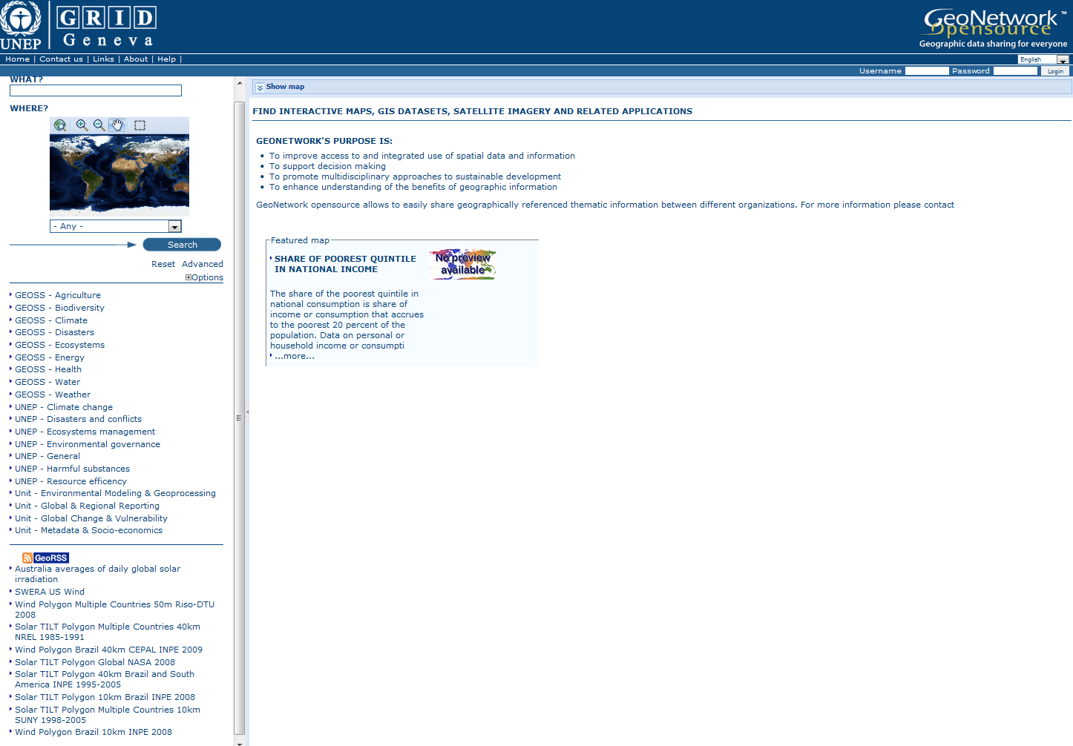
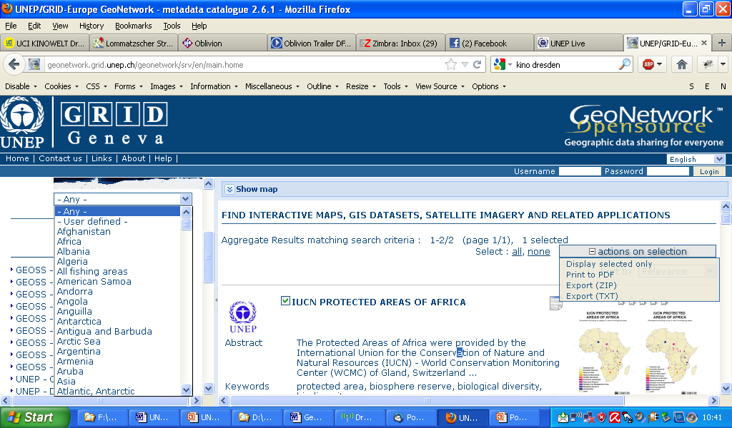
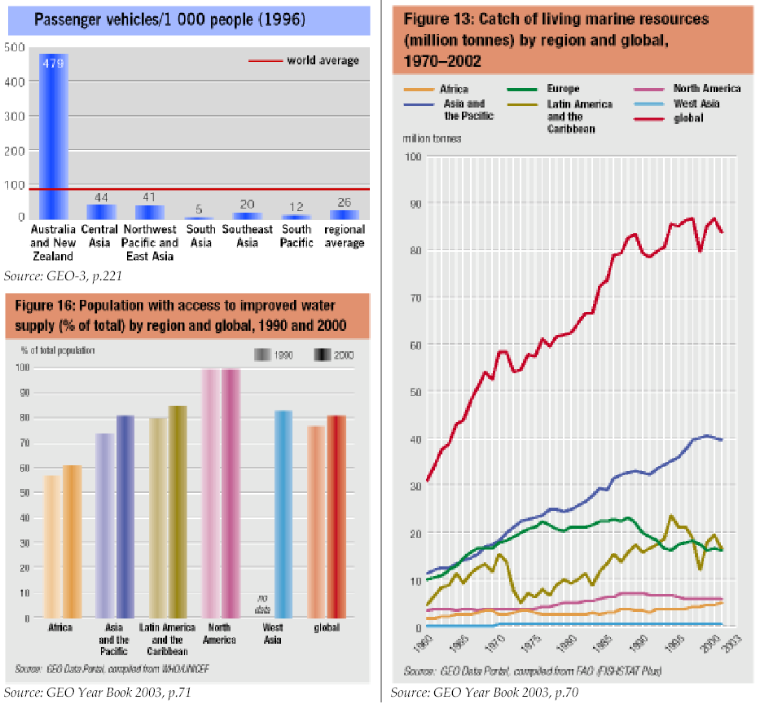
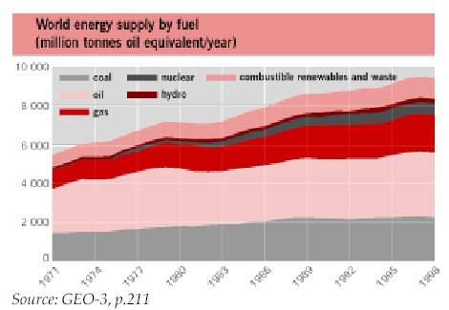
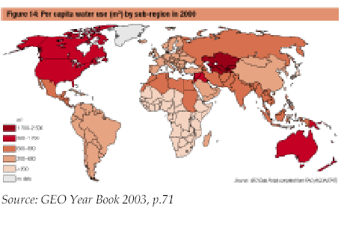
UNEP GRID‘s Geonetwork (http://geonetwork.grid.unep.ch/geonetwork)
Influenced by academia and open source community
... an authoritative source for data sets used by UNEP and its partner
Notes:
The database holds over 500 data/indicator trend variables (stats, maps) for countries, worldwide or for regions and the world, identified on the basis of a ‘core data list’ developed as part of the GEO process and covering environmental and socio-economic domains.

Slide 12
OCHA
OCHA = Office for the Coordination of Humanitarian Affairs
Mission: coordination international assistance when the scale of the disaster exceeds national capacity, comprising
  Coordination of organisations and activities
  Policy: guidance, best practices, normative standards for humanitarian work
  Advocacy: on behalf of the people worst affected by humanitarian situations
  https://ochanet.unocha.org/p/Documents/International%20legal%20framework%20in%20humanitarian%20advocacy.pdf
  Information Management
  Humanitarian Financing

Slide 13
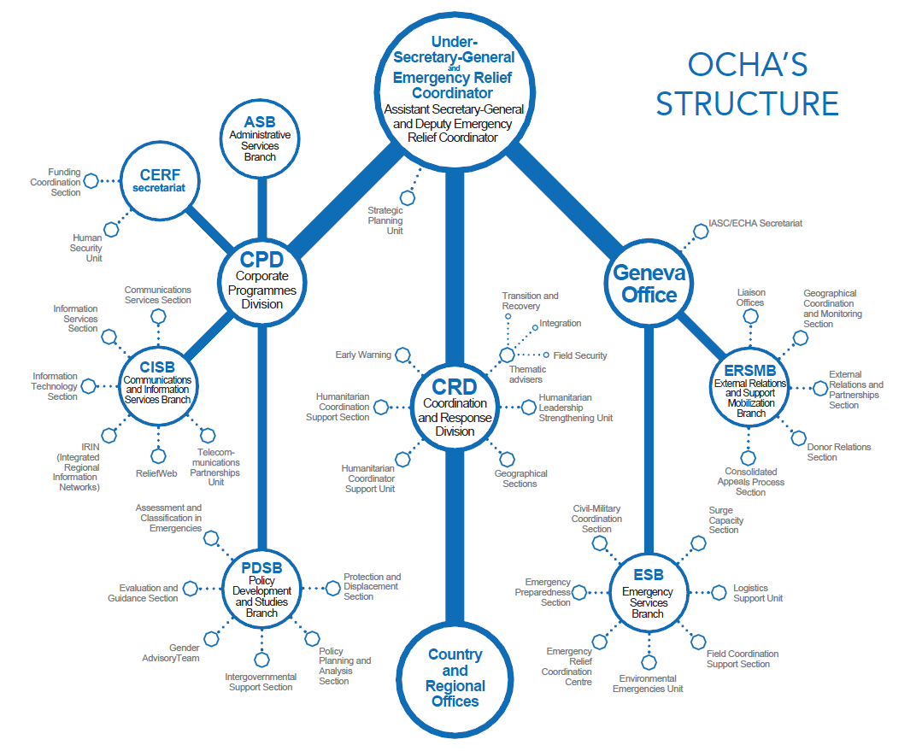

FOD
COD
P-code
Linked Data approach
Source: https://ochanet.unocha.org/p/Documents/2011%20OCHA%20Annual%20Report%20Final%20150dpi.pdf
Notes:
In all major emergencies, the environmental impact is assessed and an appropriate response is
provided, while ensuring humanitarian and environmental harm is minimised. Environmental issues are
integrated throughout the response strategy.

Slide 14
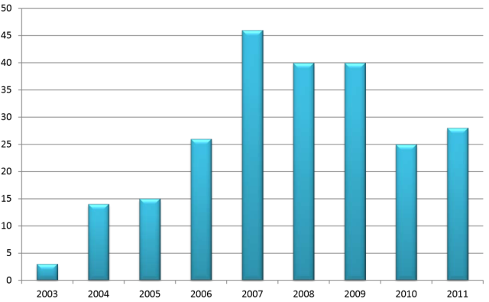
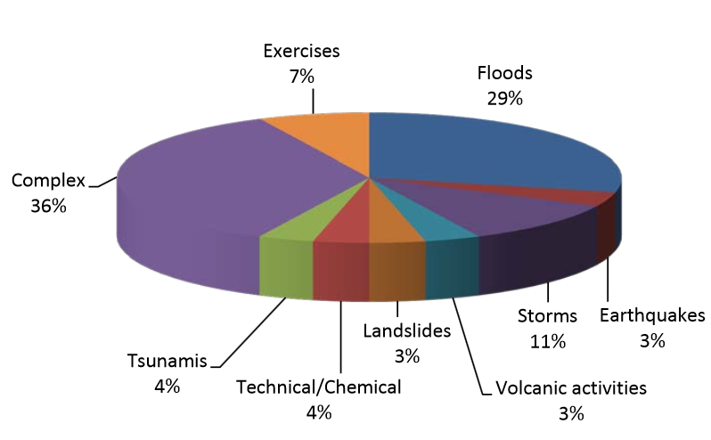
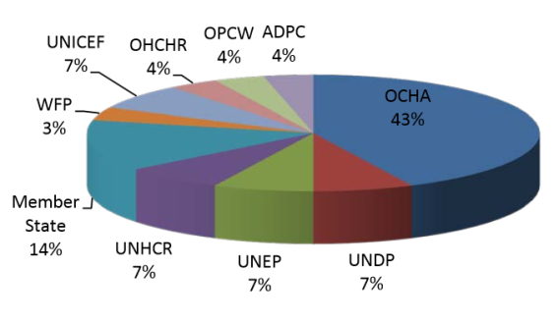
UNITAR’s Operational Satellite Applications Programme (UNOSAT)
Goal: “delivering imagery analysis and satellite solutions to relief and development organisations within and outside the UN system to help make a difference in critical areas such as humanitarian relief, human security, strategic territorial and development planning.”
Location: CERN
Activity upon request (by OCHA, UNHCR, UNICEF, WFP, UNDP, WHO, IFRC, ICRC, from NGOs, and from affected countries)
Data sources: Satellite imagery, crowdsourced data
Products: images, maps, reports and GIS data layers
http://unosat.web.cern.ch/unosat/unitar/publications/Overview2011UNOSATRapidMapping_final2.pdf

Slide 15
Information partners and information flows
Obstacles
Approaches for data dissemination
General aspects

Slide 16
NGO
NGO
NGO
Field Office
Do-nor
Field Office
Do-nor
Do-nor
Field Office
Press
Field Office
Head Quarter
(HQ)
Press
Media
UN Programme
Country
Office
UN Specialized
Agency
Country
Office
UN Commission
Country
Office
Country
Office

Slide 17
Unit
Geospatial Information
External information access
Dissemination to partners
Internal information access

Slide 18
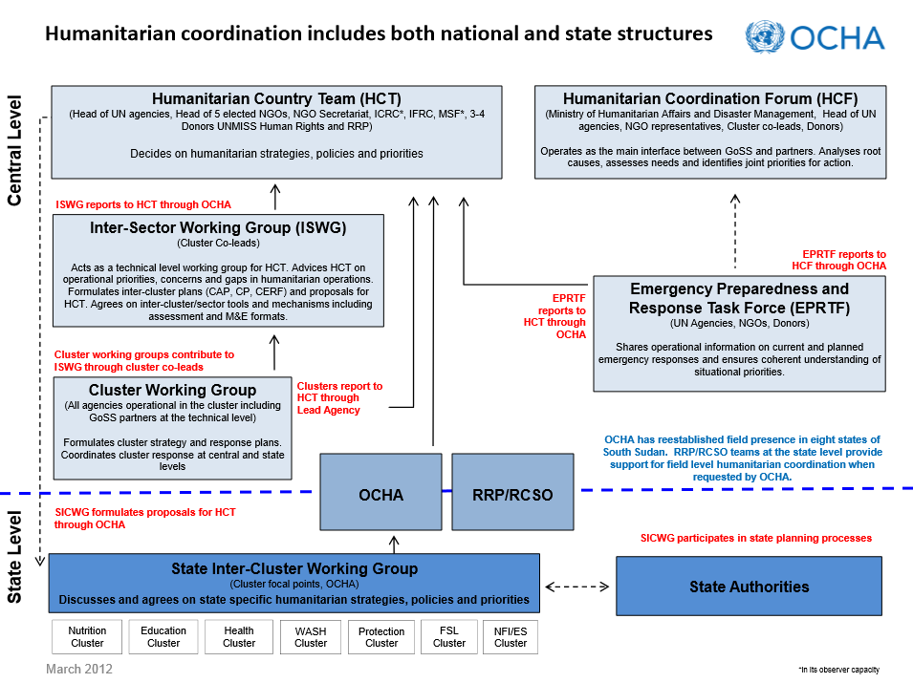
Example
https://ochanet.unocha.org/p/Documents/South%20Sudan%20Coordination%20structure.pdf

Slide 19
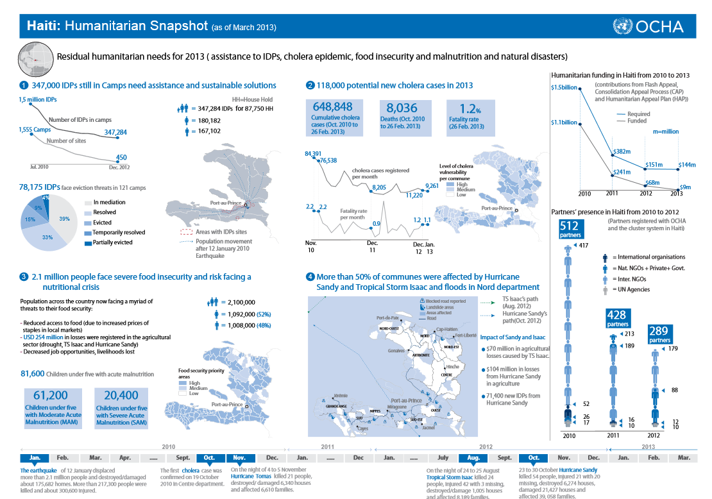
statistics
Complex
infographics
Thematic
maps
Complex
infographics
maps
statistics
http://reliefweb.int/sites/reliefweb.int/files/resources/Haiti%20Humanitarian%20Snapshot%20March%202013.pdf
Prof. Dr.-Ing. Franz-Josef Behr

Slide 20



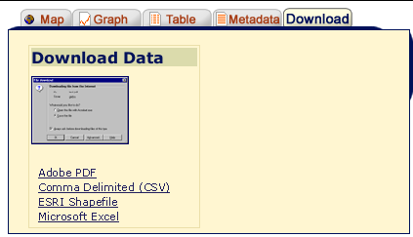
Obstacles hampering interoperability
Different formats
Different syntax
Different versions of content
Missing Metadata
Limited Accessibility (data silos)
Lack of institutional interoperability (missing MoU…)
Lack of resources for efficient information management
Varying degrees of expertise, lack of awareness about GIS capabilities
kml/kmzs
Sources: Wikipedia, http://findicons.com
FTP instead of service-orientation
PDF instead of geodata themselves
Collection of GPS data not „streamlined“
Missing connectivity to field offices, local bandwidth limitations

Slide 21
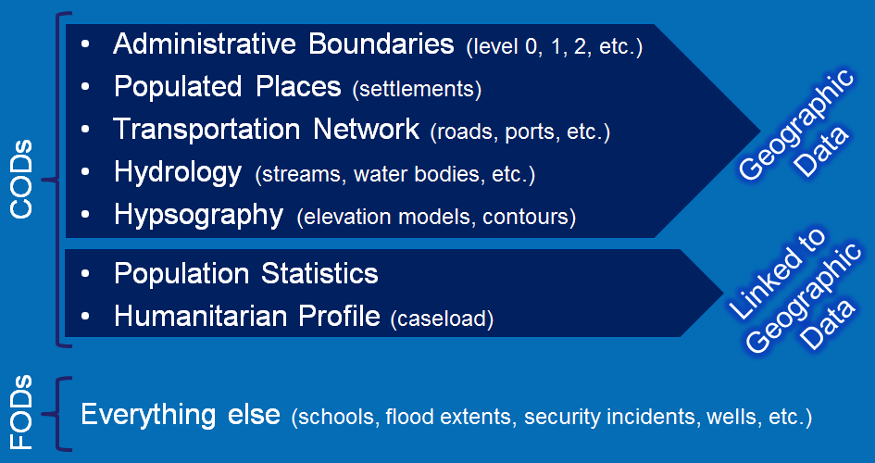
Common and Fundamental Operational Datasets
Common (“critical”) Operational Datasets (CODs): themes of common interest to support the work of humanitarian actors across multiple sectors, de facto standard for the humanitarian community and should represent the best-available datasets for each theme.
Fundamental Operational Datasets (FODs): relevant to a humanitarian operation, but more specific to a particular sector (not part of the seven COD themes)
http://cod.humanitarianresponse.info/about
Notes:
Guardian: OCHA is the “Guardian” of the agreed upon datasets and will facilitate the distribution of the “best” available common operational and fundamental datasets in emergencies while managing forums for updates and distribution communication. If OCHA is unable to provide this service in a specific country, a suitable substitute Guardian should be identified by Humanitarian Country Teams or equivalent decision-making body during contingency planning.
Sponsor: Each dataset has a designated “Sponsor” who is responsible for identifying and liaising with relevant “Sources” to analyze, collate, clean and achieve consensus around a specific operational dataset. OCHA will maintain lists of dataset Sponsors at the country and global levels and coordinate between data Sponsors.
Source: Each dataset will have designated source(s) or owner(s), such as: national authority/agency, Cluster, NGO, UN agency, International Organization, International Red Cross/Red Crescent that agrees to be fully responsible for the development, maintenance and metadata associated with a dataset and control distribution restrictions.

Slide 22
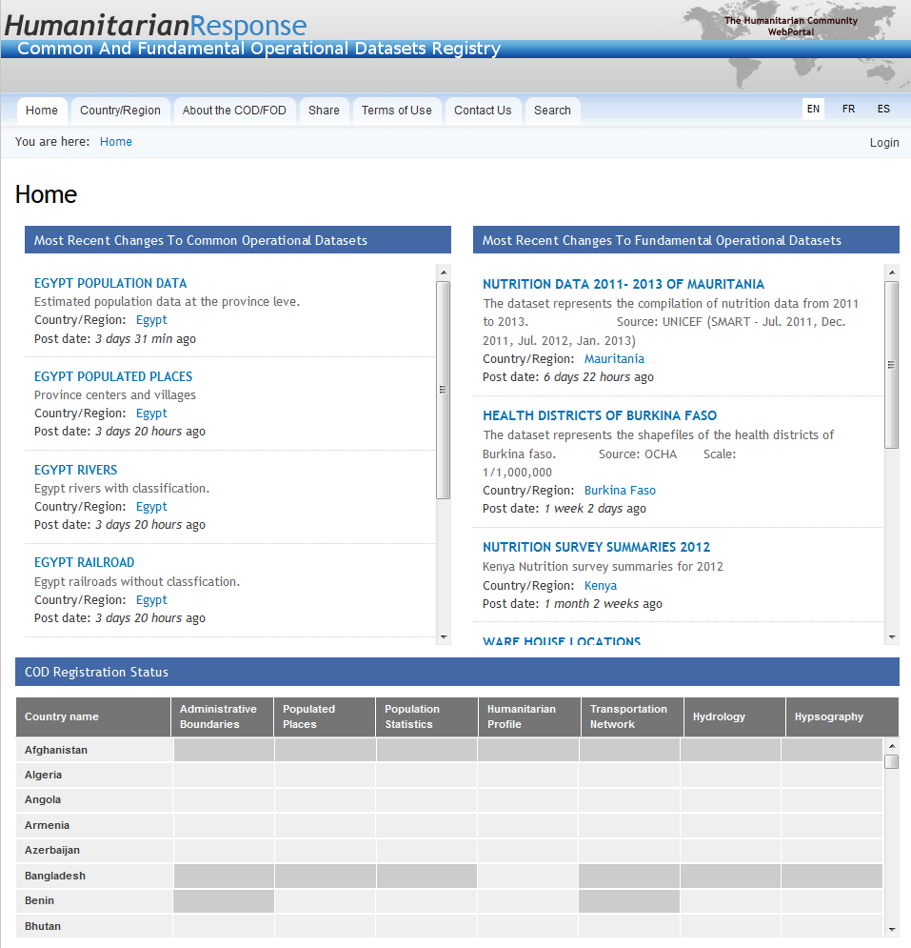
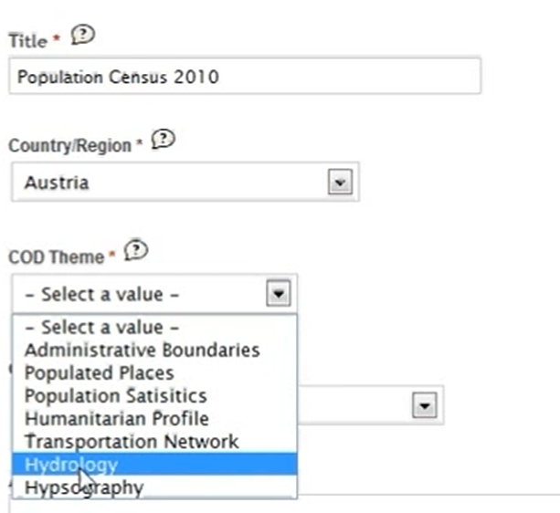
Limited, but useful range of metadata.

Slide 23
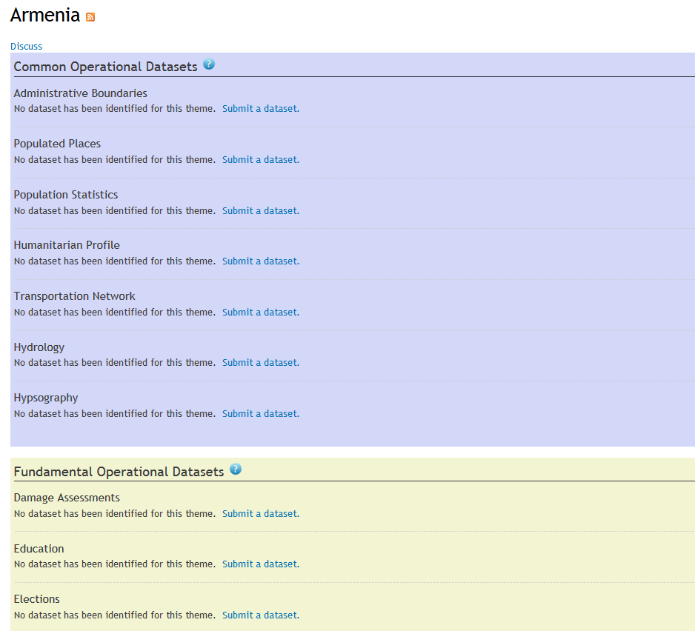
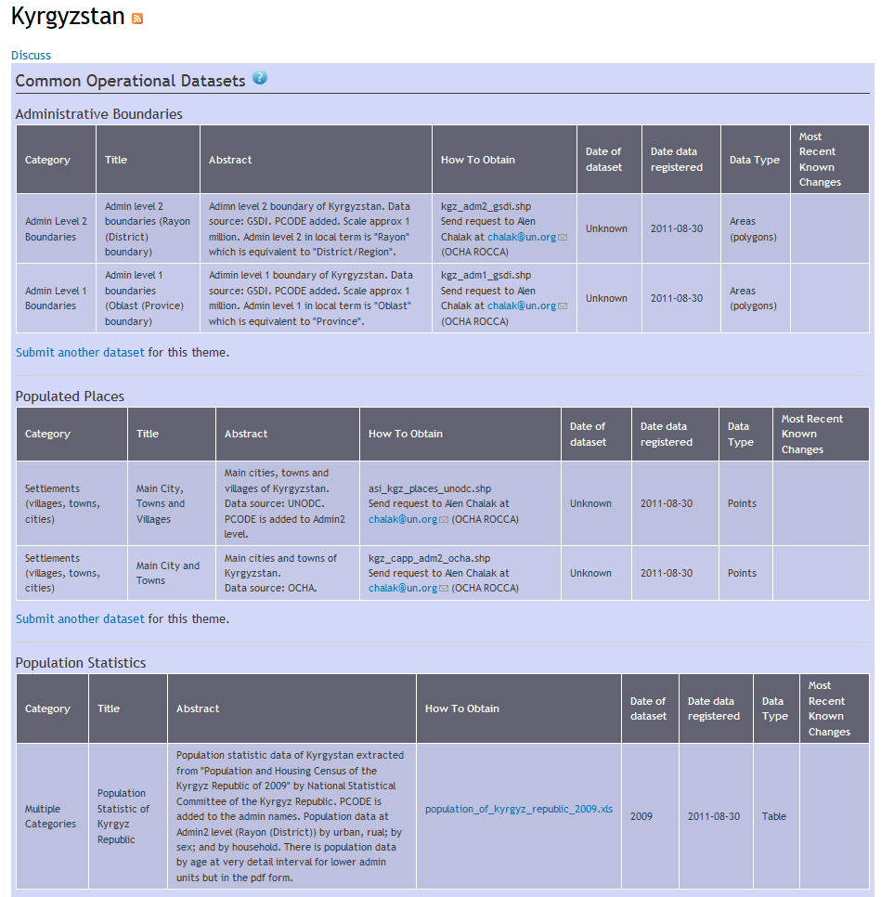

Slide 24
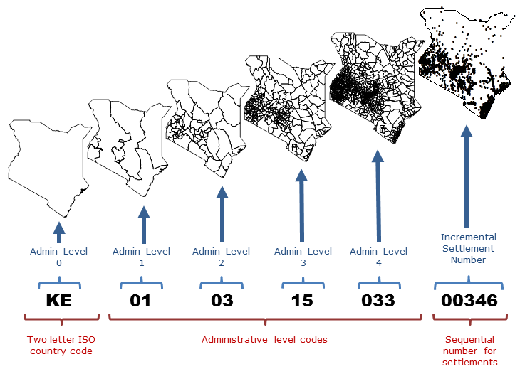
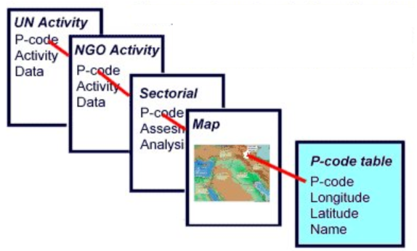
Place Codes (P-Codes)
Place names as identifiers: easily misleading in multinational context
→ introduction of a code system for uniform, unambiguous identification of a place
similar to zip codes and postal codes uniquely referencing place locations
Source: http://www.pakresponse.info/LinkClick.aspx?fileticket=PUQ7e2AjehU%3D&tabid=68&mid=475 [2013-04-23]
a systematic means of linking and exchanging data
Source: https://sites.google.com/site/ochaimwiki/geodata-preparation-manual/p-code-guidelines
Notes:
Country Code - This is taken from the ISO 2-letter country code standard. For most purposes, this code does not need to be included when giving the p-code for a place. However, one good reason for including it is that it will force any p-code to be recognized as text rather than a number, which has the advantage of being sure that leading zeroes are not dropped.
Admin 1 to Admin x - Each admin level gets a numeric code with enough leading zeros to ensure that the occasional addition of new admin units will not exceed the number of digits available. In the example below, two digits are adequate for admin levels 1 - 3 (meaning that there will not be more than 99 admin units in any one of these levels). Level 4 can have as many as 999 admin units.
Incremental Settlement Numbers - For simplicity of maintenance, it is best to use a single set of incremental numbers across the whole country (rather than within each admin unit). This has the additional advantage of allowing places to be referred to using only the settlement number without the admin unit codes, making them shorter. Enough digits should be used here to allow for the possibility of new datasets to be added.

Slide 25
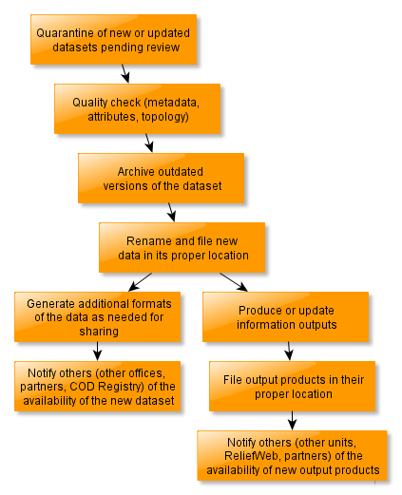
Enabling interoperability I
Idealized Data Management Workflow
?
https://sites.google.com/site/ochaimwiki/file-and-dataset-naming-manual [2013-04-25]

Slide 26
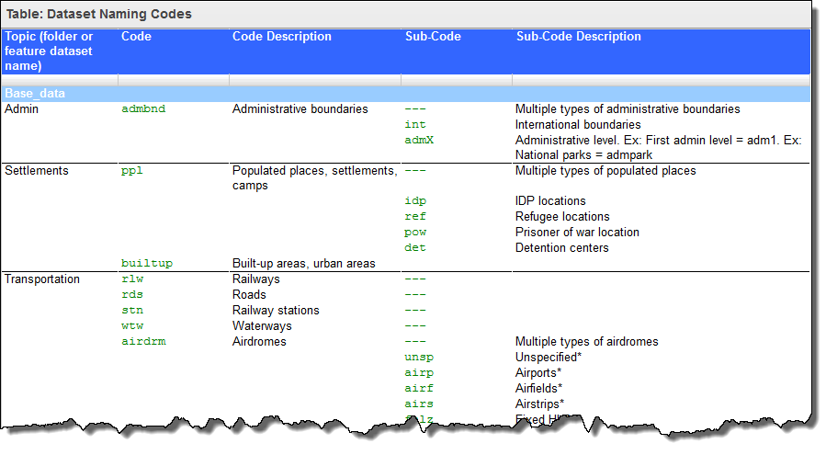
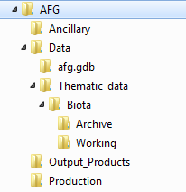
Enabling interoperability II
OCHA stores data in ESRI geodatabases which, depending on the office and the licensing, may be single-user or multiuser.
File Naming Convention
Dataset Naming Codes
Folder structure
Metadata standard(s)
Quality Check and Data Cleaning (SRS, topology)
Data Quality Checklist for COD (Administrative Boundaries, Populated Places, Population Statistics, …
Source: https://sites.google.com/site/ochaimwiki/home

Slide 27
Enabling interoperability II: Metadata
Basic Metadata:
FILE IDENTIFIER (Filename to which this metadata record applies):
POINT OF CONTACT (Person or Organization that can be contacted for acquiring knowledge about or acquisition of the resource):
METADATA DATE STAMP (The date on which the metadata record was created - YYYYMMDD):
TITLE (The title of the map or data set, the name by which the cited resource is known):
DATASET REFERENCE DATE (The date on which the data set was published or created):
DATASET REFERENCE DATE TYPE (Does the date above indicate publication or creation):
ABSTRACT (A brief narrative summary of the content of the dataset):
RESOURCE PROVIDER (The person or organization that provides the resource, the source of the dataset):
PLACE KEYWORD (A keyword that describes the geographical extent of the data set):
DATASET LANGUAGE (The language or languages of any text information in the data set):
COORDINATE REFERENCE SYSTEM (The projection and datum used for geographic data):
DATA DICTIONARY (Description of the contents of all attributes and coded values in the dataset):
DISTRIBUTION INFORMATION (Description of distribution rights, to the extent it is known):
Full Metadata: UNGIWG subset of the ISO 19115 metadata standard; ArcCatalog as a metadata editor

Slide 28
Current approach:
Interoperability by Linked Data
Linked Data: based on statements
URIs (URLs) act as unique identifiers for subjects, properties and objects
„Triple“
Dresden
is within
Free State of Saxony
Subject
Predicate
Object
URI
URI
URI or Literal
http://www.dresden.de
http://sachsen.de/
http://hxl.humanitarianresponse.info#within

Slide 29
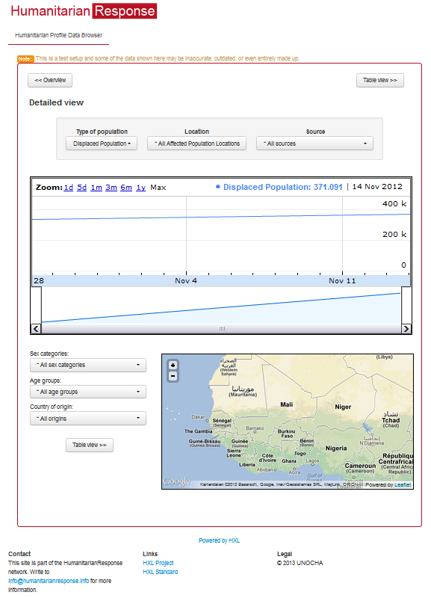
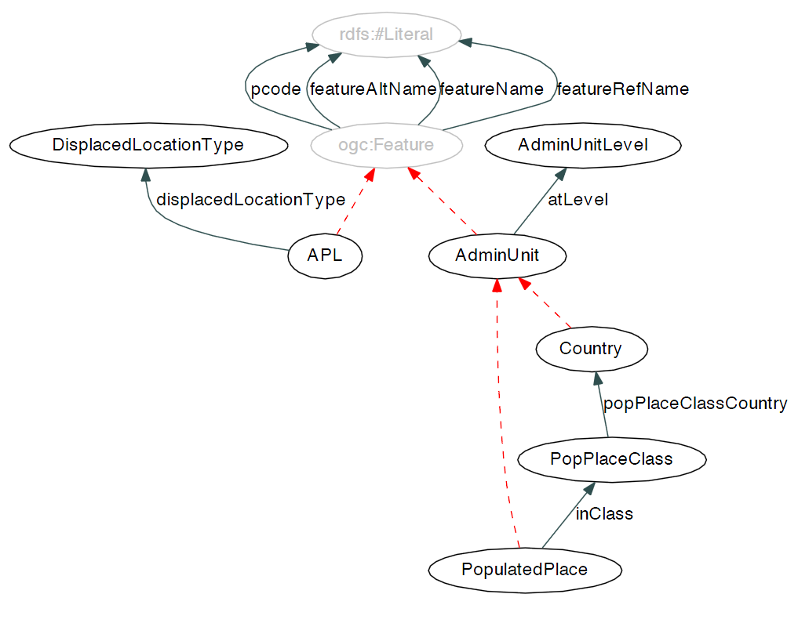
Current approach:
Interoperability by Linked Data II
Humanitarian eXchange Language (HXL)
Source: http://hxl.humanitarianresponse.info/dashboard/ [2013-04-25]
Carsten Keßler & Chad Hendrix (2013): The Humanitarian eXchange Language: Coordinating Disaster Response with Semantic Web Technologies. http://www.semantic-web-journal.net/content/humanitarian-exchange-language-coordinating-disaster-response-semantic-web-technologies-0 [2014-03-05]

Slide 30
Summary

Slide 31
Very interesting, acronym-rich, extremly complex, dynamic environment
Up-to-date technology partially used (i.e. GeoNetwork), further extensions / developments needed
Interoperability, i.e. OGC webservices, should be extended
Linked data approach should be observed
Interoperable geodata can give very helpful information
  To save money
  Time
  Resources
  lives

Slide 33
http://www.gripweb.org/gripweb/
http://www.hewsweb.org/hp/
http://www.humanitarianresponse.info/

Slide 34
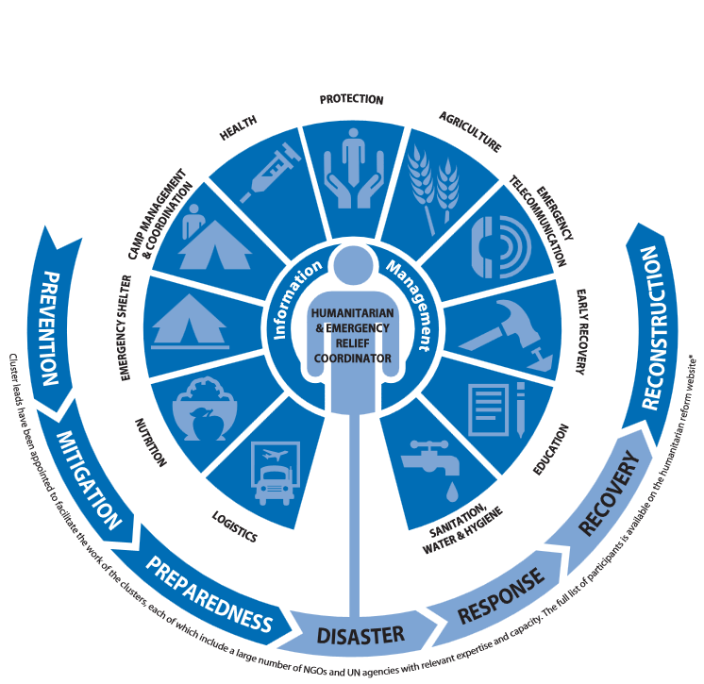
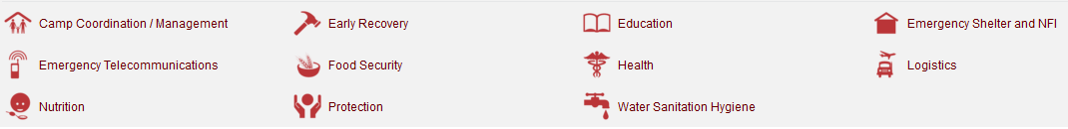
Source: http://business.un.org/en/assets/39c87a78-fec9-402e-a434-2c355f24e4f4.pdf
http://www.humanitarianresponse.info/

